Slide 1
BY ANKITA SHARMA

Slide 2


Slide 3






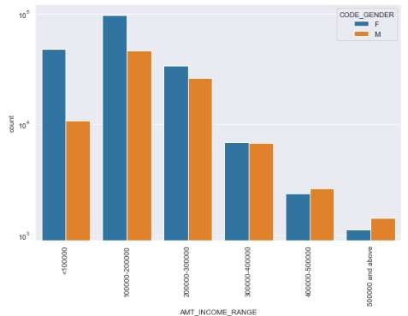



Points to be concluded from the
graph on the right side.
◻
Female counts are higher than male.
Income range from 100000 to 200000 is having more number of credits.
This graph show that females are more than male in having credits for that range.
Very less count for income range 500000 and above.
◻
◻
◻

Slide 4

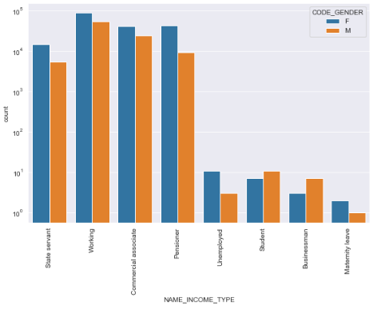
Points to be concluded from the
graph on the right.
◻
For income type
‘working’, ’commercial associate’, and ‘State Servant’ the number of credits are higher than others.
For this Females are having more number of credits than male.
Less number of credits for income type ‘student’
,’pensioner’,
‘Businessman’ and ‘Maternity leave’.
◻
◻

Slide 5

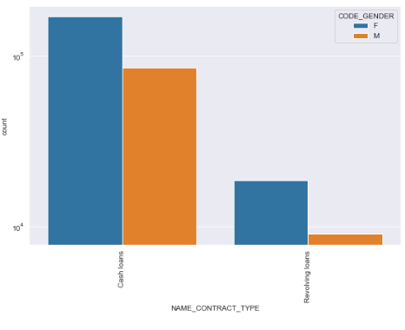
Points to be concluded from the
graph on the right.
◻ For contract type ‘cash loans’ is having higher number of credits than
‘Revolving loans’ contract type.
◻ For this also Female is leading for applying credits.

Slide 6

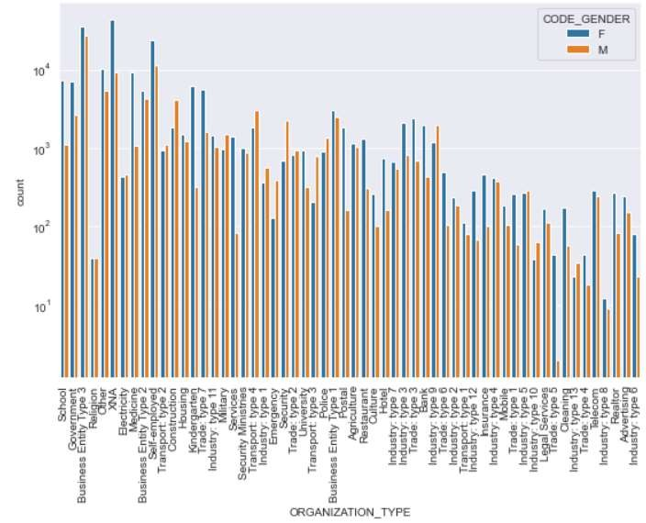
Points to be concluded from the
graph on the right.
◻
Clients which have applied for credits are from most of the organization type
‘Business entity Type 3’ , ‘Self employed’ , ‘Other’ , ‘Medicine’ and
‘Government’.
Less clients are from Industry type 8,type 6, type 10, religion and trade type 5, type 4.
◻

Slide 8

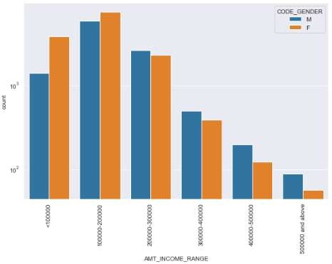
Points to be concluded from the
graph on the right side.
◻
Male counts are higher than female.
Income range from 100000 to 200000 is having more number of credits.
This graph show that males are more than female in having credits for that range.
Very less count for income range 400000 and above.
◻
◻
◻

Slide 9
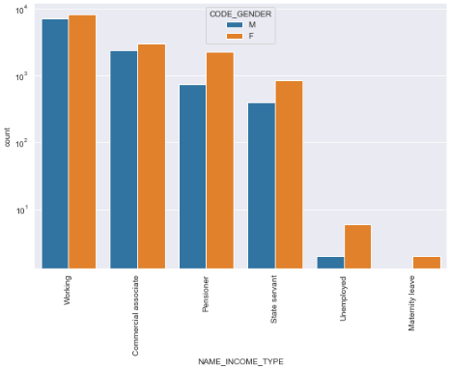
Points to be concluded from the graph on the right side.
◻
For income type ‘working’,
’commercial associate’, and
‘State Servant’ the number of
credits are higher than other
i.e. ‘Maternity leave.
For this Females are having more number of credits than male.
Less number of credits for income type ‘Maternity leave’.
For type 1: There is no
income type for ‘student’ , ’pensioner’ and
‘Businessman’ which means
they don’t do any late payments.
◻
◻
◻

Slide 10
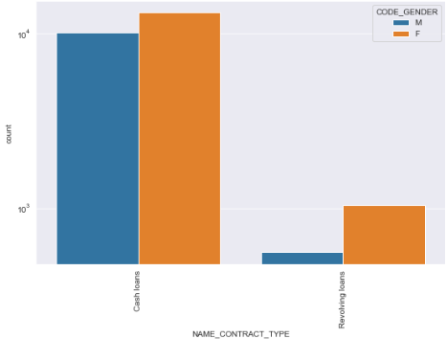
Points to be concluded from the
graph on the right.
◻
For contract type ‘cash loans’ is having higher number of credits than
‘Revolving loans’ contract type.
For this also Female is leading for applying credits.
For type 1 : there is only
Female Revolving loans.
◻
◻

Slide 11
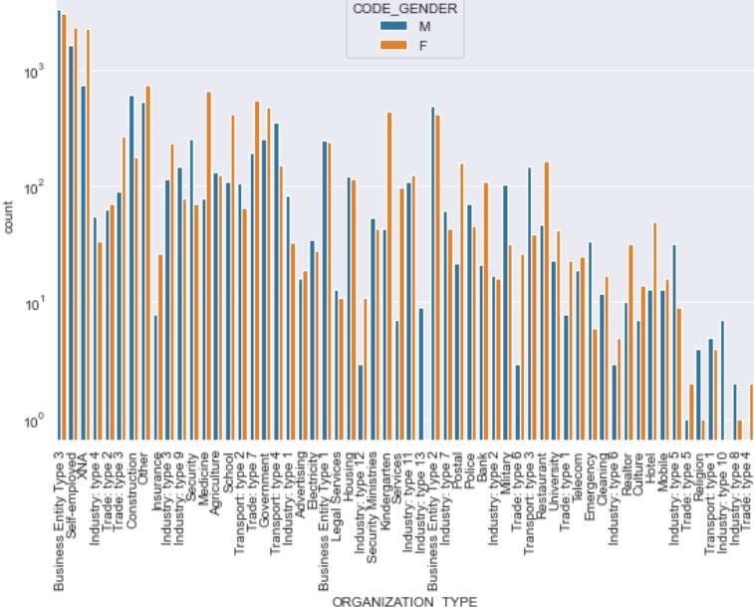
Points to be concluded from the
graph on the right.
◻
Clients which have applied for credits are from most of the organization type
‘Business entity Type 3’ , ‘Self employed’ , ‘Other’ , ‘Medicine’ and
‘Government’.
Less clients are from Industry type 8,type 6, type 10, religion and trade type 5, type 4.
Same as type 0 in distribution of organization type.
◻
◻

Slide 12


Slide 13
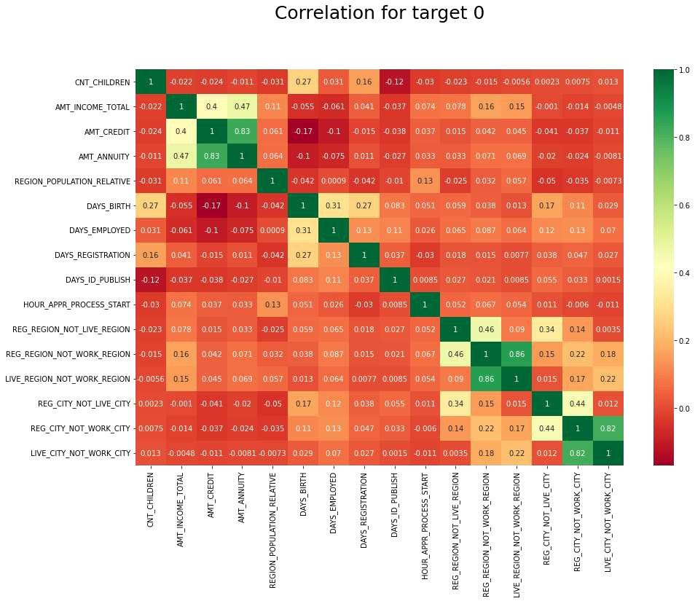

Slide 14

◻ Credit amount is inversely proportional to the date of birth, which means
Credit amount is higher for low age and vice-versa.
◻ Credit amount is inversely proportional to the number of children client have, means Credit amount is higher for less children count client have and vice-versa.
◻ Income amount is inversely proportional to the number of children client have, means more income for less children client have and vice-versa.
◻ less children client have in densely populated area. Credit amount is higher to densely populated area. The income is also higher in densely populated area.

Slide 15
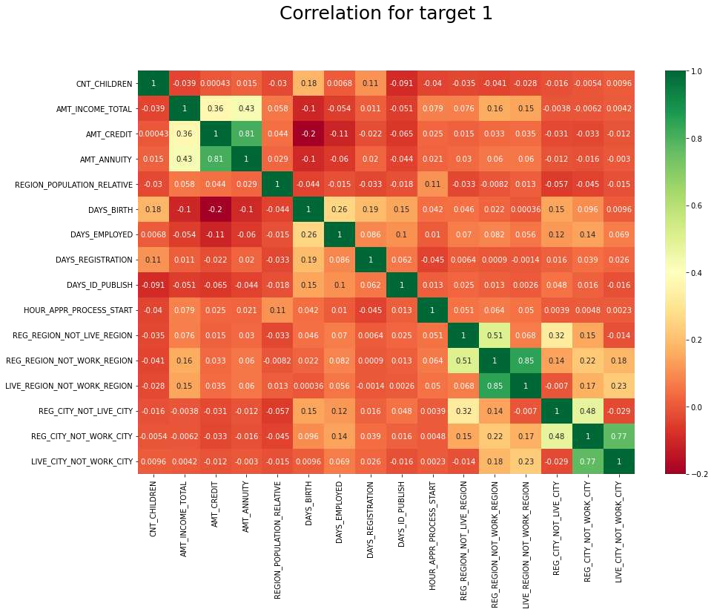

Slide 16

This heat map for Target 1 is also having quite a same observation just like Target 0. But for few points are
different. They are listed below.
◻ Heat map for Target 1 is also having quite a same observation just like Target 0. But for few points are different.
◻ The client's permanent address does not match contact address are having less children and vice-versa.
◻ The client's permanent address does not match work address are having less children and vice-versa.

Slide 17


Slide 18

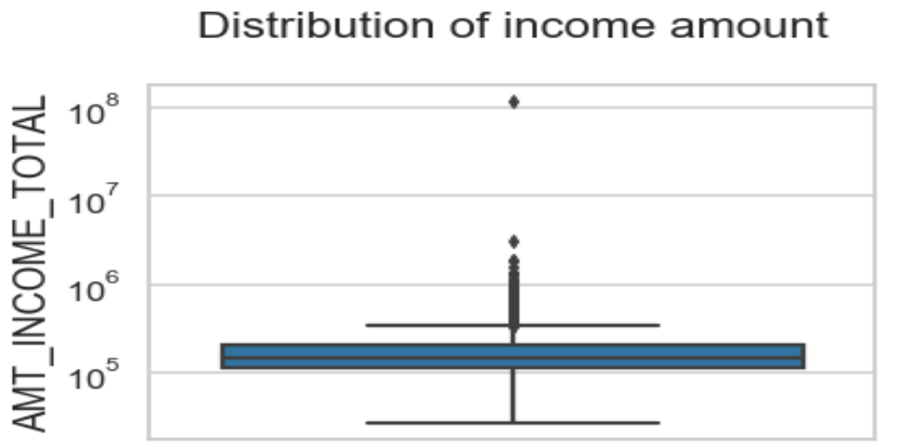
Few points can be concluded from the graph.
◻ Some outliers are noticed in income amount.
◻ The third quartiles is very slim for income amount.

Slide 19




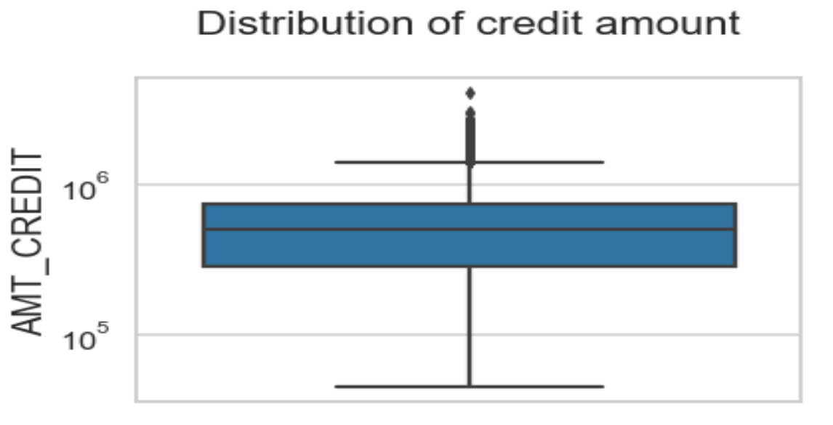



Few points can be concluded from the graph.
◻ Some outliers are noticed in credit amount.
◻ The first quartile is bigger than third quartile for credit amount which means most of the credits of clients are present in the first quartile.

Slide 20

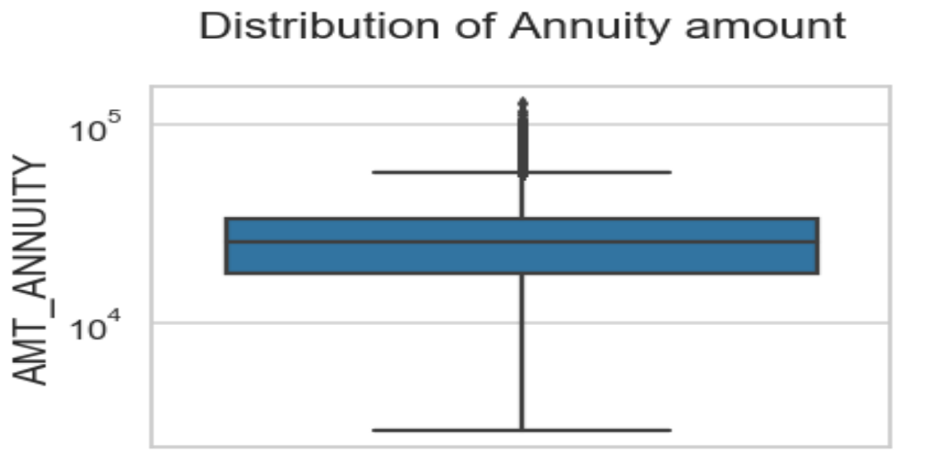
Few points can be concluded from the graph.
◻ Some outliers are noticed in annuity amount.
◻ The first quartile is bigger than third quartile for annuity amount which means most of the annuity clients are from first quartile.

Slide 21


Slide 22

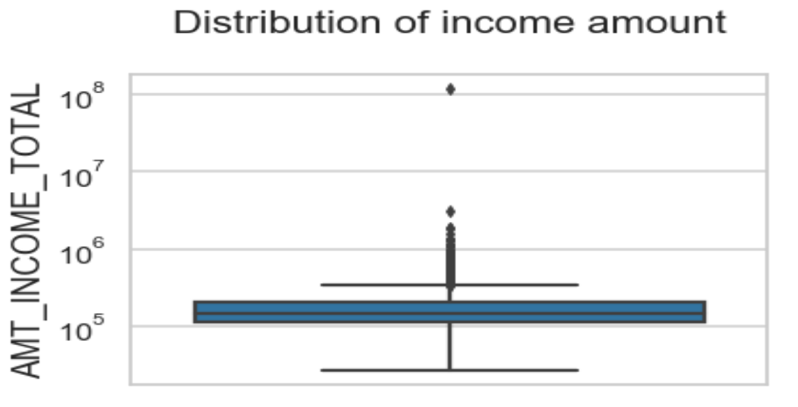
Few points can be concluded from the graph.
◻ Some outliers are noticed in income amount.
◻ The third quartiles is very slim for income amount.
◻ Most of the clients of income are present in first quartile.

Slide 23
Few points can be concluded from the graph.
◻ Some outliers are noticed in credit amount.
◻ The first quartile is bigger than third quartile for credit amount which means most of the credits of clients are present in the first quartile.

Slide 24
Few points can be concluded from the graph.
◻ Some outliers are noticed in annuity amount.
◻ The first quartile is bigger than third quartile for annuity amount which means most of the annuity clients are from first quartile.

Slide 26
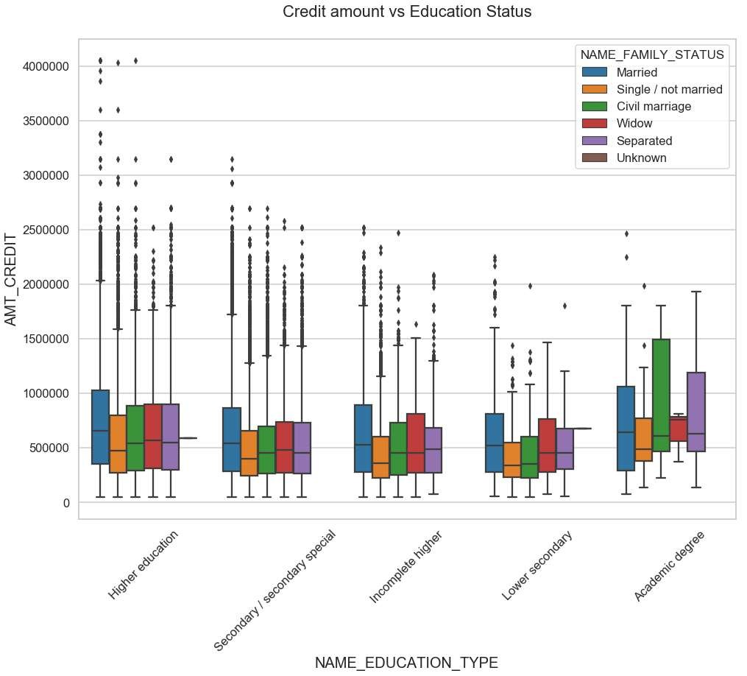

Few points can be concluded
from the graph.
◻
Family status of 'civil marriage', 'marriage' and 'separated' of Academic degree education are having higher number of credits than others.
Higher education of family status of 'marriage', 'single' and 'civil marriage' are having more outliers.
Civil marriage for Academic degree is having most of the credits in the third quartile.
◻
◻

Slide 27
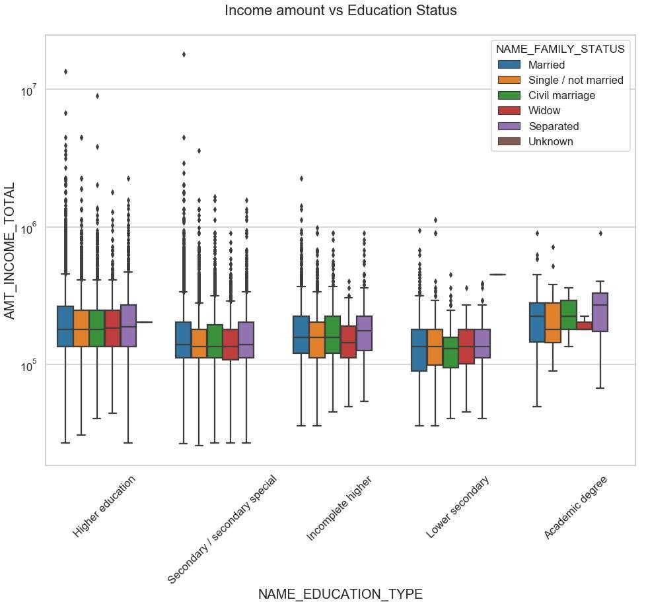

Few points can be concluded
from the graph.
◻
For Education type 'Higher education' the income amount mean is mostly equal with family status. It does contain many outliers.
Less outlier are having for Academic degree but they are having the income amount is little higher that Higher education.
Lower secondary of civil marriage family status are have less income amount than others.
◻
◻

Slide 29
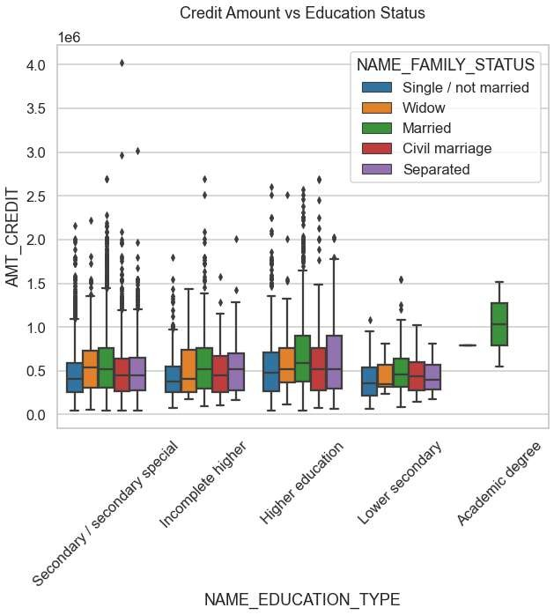
Few points can be concluded from the graph.
◻
Quite similar from Target 0, we can say that Family status of 'civil marriage', 'marriage' and 'separated' of Academic degree education are having higher number of credits than others.
Most of the outliers are from Education type 'Higher education' and 'Secondary’.
Civil marriage for Academic degree is having most of the credits in the third quartile.
◻
◻

Slide 30
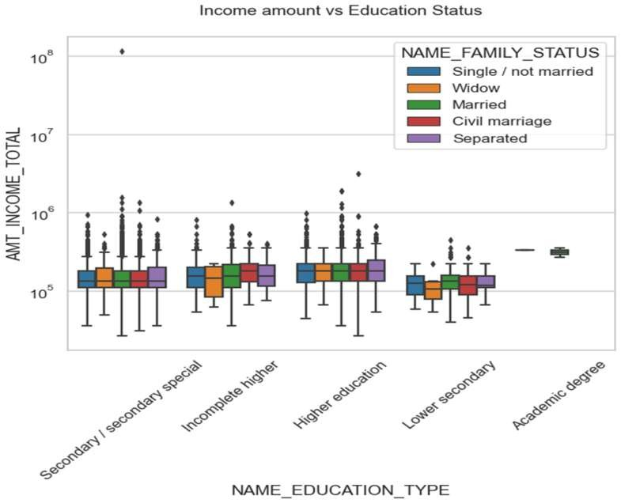
Few points can be concluded from the graph.
◻
Have some similarity with Target0, From above boxplot for Education type 'Higher education' the income amount is mostly equal with family status.
◻
Less outlier are having for Academic degree but there income amount is little higher that Higher education.
◻
Lower secondary are have less income amount than others.

Slide 31


Slide 32
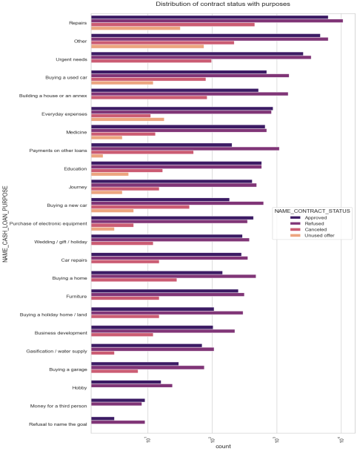

Few points can be concluded
from the graph.
◻
Most rejection of loans came from purpose 'repairs'.
◻
For education purposes we have equal number of approves and rejection
◻
Paying other loans and buying a new car is having significant higher rejection than approves.

Slide 33

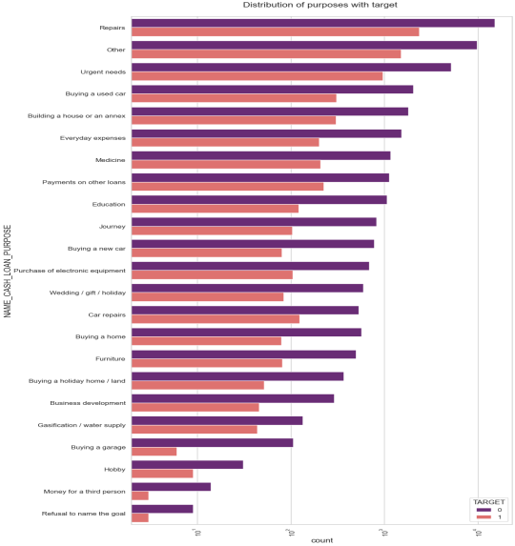
Few points can be concluded from the graph.
◻
Loan purposes with 'Repairs' are facing more difficulties in payment on time.
◻
There are few places where loan payment is significant higher than facing difficulties. They are 'Buying a garage', 'Business development', 'Buying land’, 'Buying a new car' and 'Education' Hence we can focus on these purposes for which the client is having for minimal payment difficulties.

Slide 35
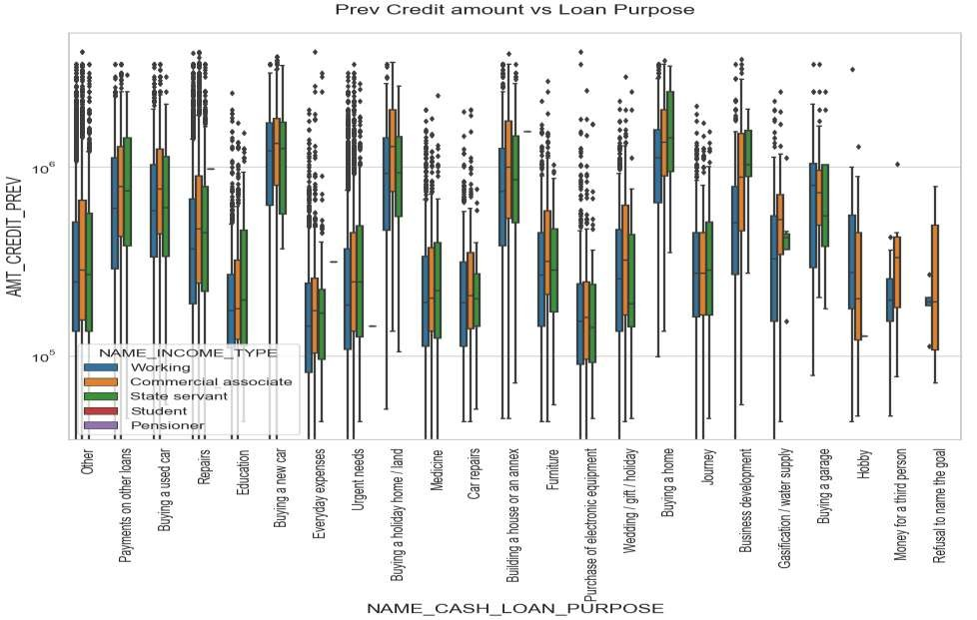

Slide 36
From the previous graph we can conclude the below points:
◻ The credit amount of Loan purposes like 'Buying a home‘, 'Buying a land‘, 'Buying a new car' and 'Building a house' is higher.
◻ Income type of state servants have a significant amount of credit applied
◻ Money for third person or a Hobby is having less credits applied for.

Slide 37
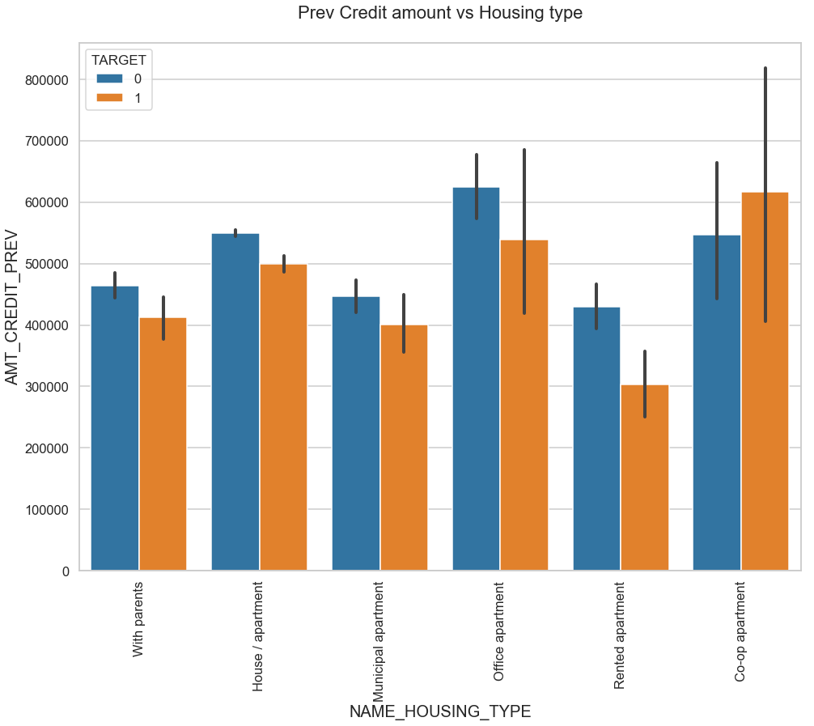

Few points can be concluded
from the graph.
◻
Here for Housing type, office apartment is having higher credit of target 0 and co-op apartment is having higher credit of target 1.
So, we can conclude that bank should avoid giving loans to the housing type of co-op apartment as they are having difficulties in payment.
Bank can focus mostly on housing type with parents or House\apartment or municipal apartment for successful payments.
◻
◻

Slide 38

◻ Banks should focus more on contract type ‘Student’ ,’pensioner’ and ‘Businessman’ with housing ‘type other than ‘Co-op apartment’ for successful payments.
◻ Banks should focus less on income type ‘Working’ as they are having most number of unsuccessful payments.
◻ Also with loan purpose ‘Repair’ is having higher number of unsuccessful payments on time.
◻ Get as much as clients from housing type ‘With parents’ as they are having least number of unsuccessful payments.

Slide 39


